Slide 1
CT098-3-2: Research Methods in Computing and Technology
Data Analysis

Slide 2
TOPIC LEARNING OUTCOMES
At the end of this topic, you should be able to:
Elaborate on quantitative data
Describe the various considerations for quantitative data analysis

Slide 3
Contents & Structure
Analysing Quantitative Data
Techniques
Considerations for quantitative data analysis

Slide 4
Recap From Last Lesson
When suitable to conduct interview?
How many types of interview?

Slide 5
Quantitate Data
Raw form
Numerical data
Should help to
Answer research questions
Meet research objectives
Needs to be analysed and interpreted – quantitative analysis techniques

Slide 6
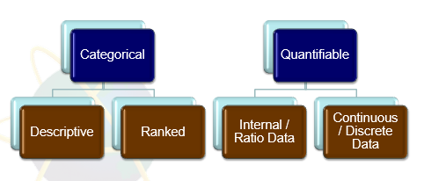
Type of data

Slide 7
Categorical Data
cannot be measured numerically.
can be classified into sets (categories) according to characteristics.
can be placed in rank order .
can further be subdivided into descriptive (nominal data) and ranked (ordinal data)

Slide 8
Descriptive Data
Also known as nominal data.
Nominal data is “labeled” or “named” data which can be divided into various groups that do not overlap.
Data is not measured or evaluated in this case, it is just assigned to multiple groups.
These groups are unique and have no common elements.

Slide 9
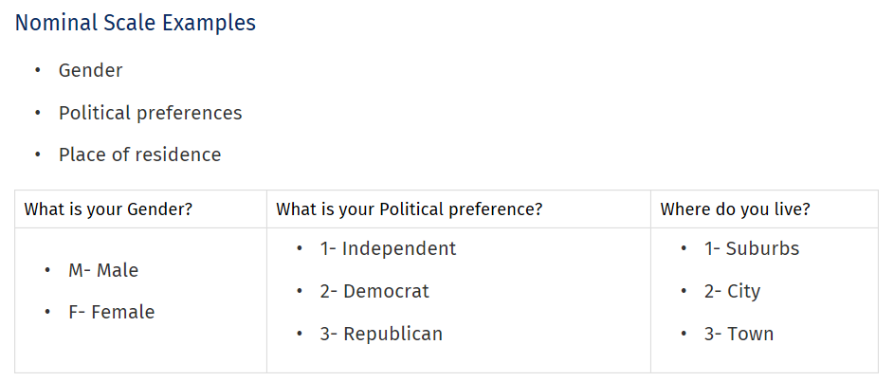
Sources: 2020 QuestionPro Survey Software

Slide 10
Ranked Data
Also known as ordinal data.
Used to simply depict the order of variables and not the difference between each of the variables.
These scales are generally used to depict non-mathematical ideas such as frequency, satisfaction, happiness, a degree of pain etc.

Slide 11
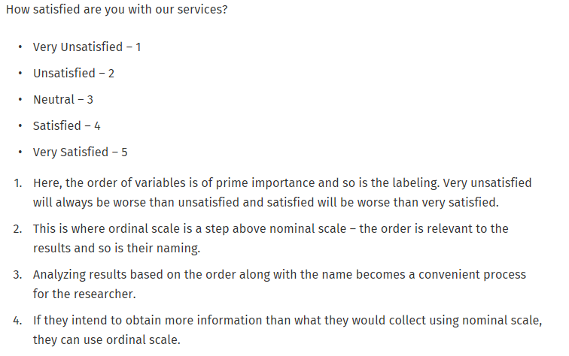
Sources: 2020 QuestionPro Survey Software

Slide 12
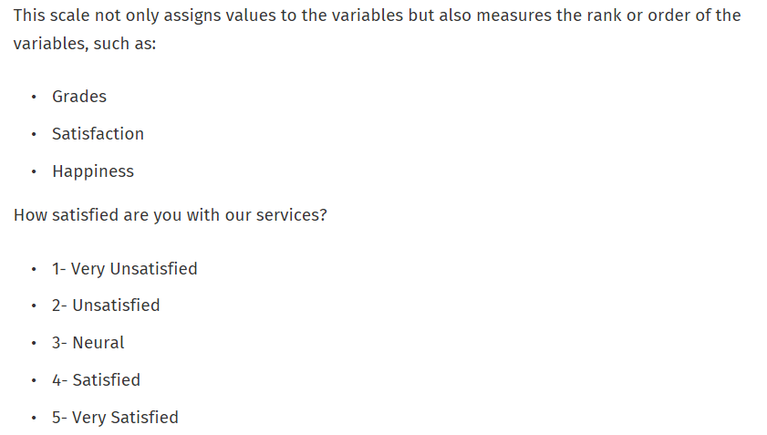

Slide 13
Quantifiable Data
Values are measured numerically as quantities.
More precise than categorical.
Can assign each data value a position on a numerical scale

Slide 14
Interval Data
Data type which is measured along a scale, in which each point is placed at equal distance from one another.
Interval data always appears in the form of numbers or numerical values where the distance between the two points is standardized and equal.
Interval data is measured on an interval scale.

Slide 15
Interval data examles
Interval data examples:
Temperature
IQ test (intelligence scale).
Test scores such as the SAT and ACT test scores.

Slide 16
Ratio Data
Ratio scale allows any researcher to compare the intervals or differences.
Ratio scale is possesses a zero point or character of origin.
All the measurement starts from zero.

Slide 17
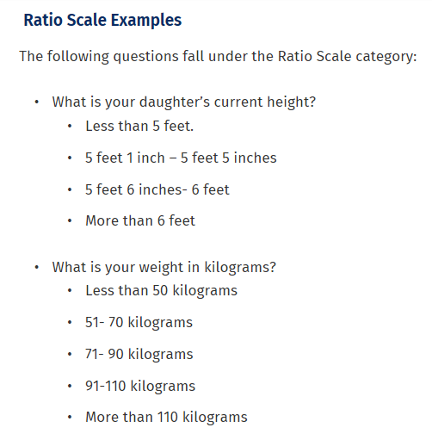
Sources: 2020 QuestionPro Survey Software

Slide 18
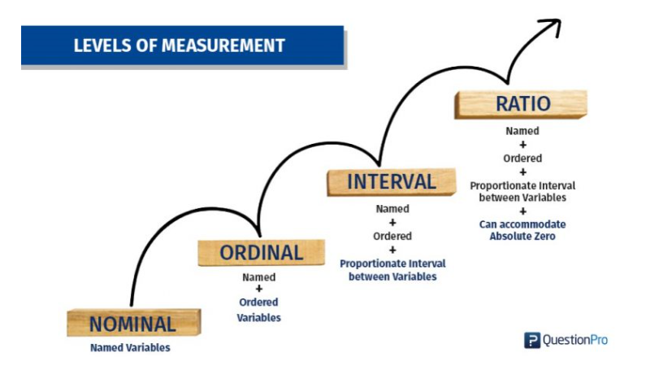
Sources: 2020 QuestionPro Survey Software

Slide 19
Discrete Data
Countable in a finite amount of time.
Example:
You can count the change in your pocket. You can count the money in your bank account.
You could also count the amount of money in everyone’s bank accounts.
It might take you a long time to count that last item, but the point is—it’s still countable.

Slide 20
Continuous Data
Would (literally) take forever to count.
Infinite to count.
Example:
Take age. You can’t count “age”. Because it would literally take forever.
you could be: 25 years, 10 months, 2 days, 5 hours, 4 seconds, 4 milliseconds, 8 nanoseconds, 99 picosends…and so on

Slide 21
What factors determine the most appropriate statistical techniques?
Research objectives / questions / purpose of your study
Measurement scales you used in your research instrument
Research design of your studies.

Slide 22
Review Questions
Describe what a researcher would need to consider when doing a quantitative analysis

Slide 23
Summary / Recap of Main Points
Data analysis process and types

